Slide 1

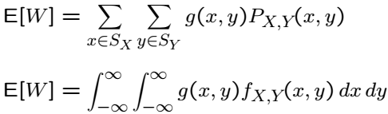

Expectations and Variance: 2 RVs
We already covered:
Expectation is linear:

Slide 3

Variance: 2 RVs
Can use definition to prove:
Last term is related to “covariance”:
We will see more about (normalized) covariance later.

Slide 4

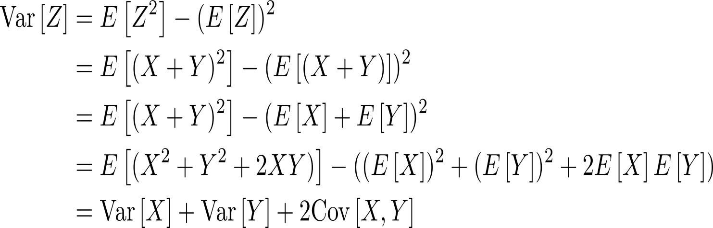
Variance of a Sum

Slide 6
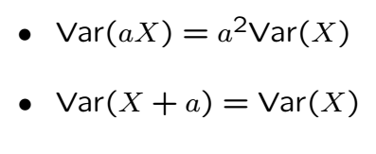
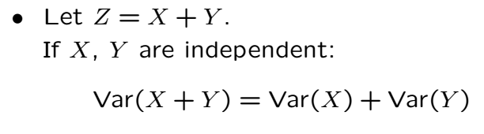
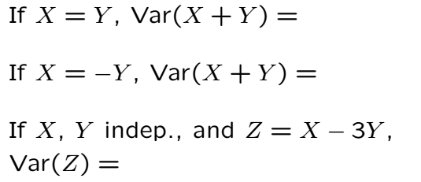
Variance Properties Cont’

Slide 7
Acknowledgements and Citations
Parts of these slides are adapted from the following resources:
Power Point Lecture Slides for the Textbook http://bcs.wiley.com/hebcs/Books?action=index&bcsId=8676&itemId=1118324560
John Tsitsiklis. 6.041 Probabilistic Systems Analysis and Applied Probability, Fall 2010. (Massachusetts Institute of Technology: MIT OpenCourseWare),http://ocw.mit.edu (Accessed 13 Apr, 2015). License: Creative Commons BY-NC-SA

